Slide 1

LET’S MAKE YOUR FITNESS JOURNEY easier with a little help FROM US! BY DENISE SANTOS
FITNESS
FITNESS
FITNESS
FITNESS
FITNESS
FITNESS
FITNESS
WORKOUT
GENERATOR

Slide 2

QUICK
WHAT does it do?
WHY choose WORKOUT GENERATOR?
HOW DOES IT WORK?
Step by step
URL - TRY IT OUT AND GET YOUR WORKOUT SCHEDULE FOR THE MONTH!
Meet our team
PRACTICAL
EASY!

Slide 3

THE WORKOUT
GENERATOR??
WHAT does it do?
The Workout Generator is designed for individuals with an intermediate understanding of exercise routines who can work out independently without a personal trainer. If you're tired of creating your own workout routine every few months or simply want to save money, the Workout Generator is perfect for you! It creates a customized workout schedule based on your preferences, such as the muscles you want to train and the number of days per week you plan to work out.

Slide 4

WHY CHOOSE WORKOUT GENERATOR
PERSONAL
TRAINING
PERSONAL
TRAINING
PERSONAL
TRAINING
PERSONAL
Practical
Time saving
Economical
Easy to use

Slide 5
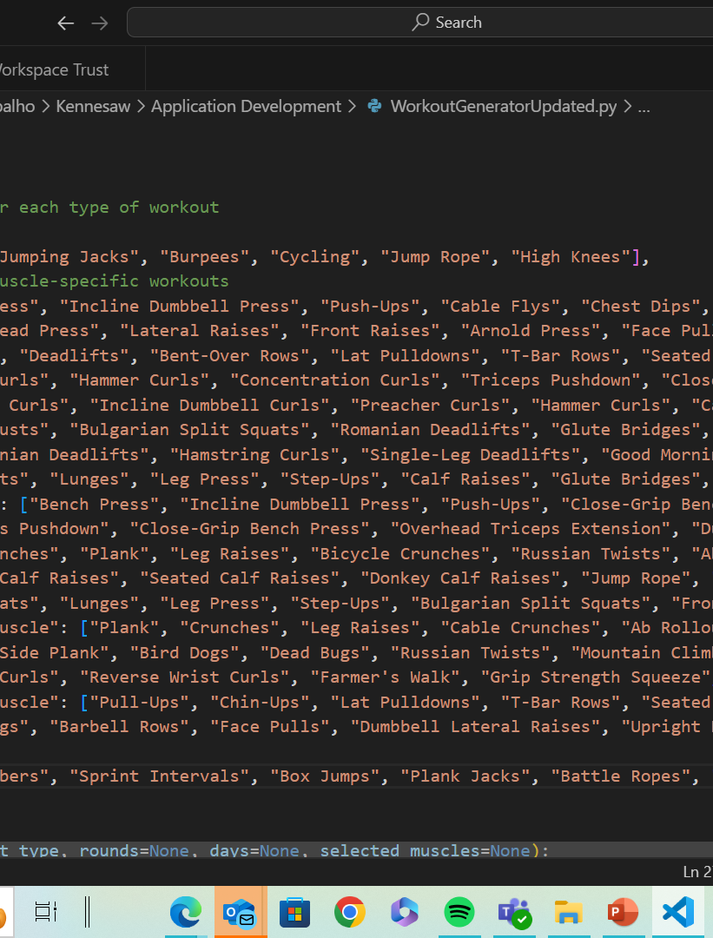
How does it work?
The Workout Generator currently includes over 130 exercises and has the potential to expand even further. Designed for users with a basic understanding of exercise routines, the program allows individuals to select the muscles they want to train and specify the number of workout days. This ensures that users can make informed decisions about their fitness goals and create tailored routines. The Workout Generator gathers user preferences and randomly selects exercises based on those choices, making it a convenient tool for creating diverse and effective workout plans. Future updates aim to enhance personalization by incorporating features such as series and repetition counts, weight recommendations for weightlifting, and the ability to select a fitness level—beginner, intermediate, or advanced. These planned enhancements promise a more customized and user-friendly experience.

Slide 6
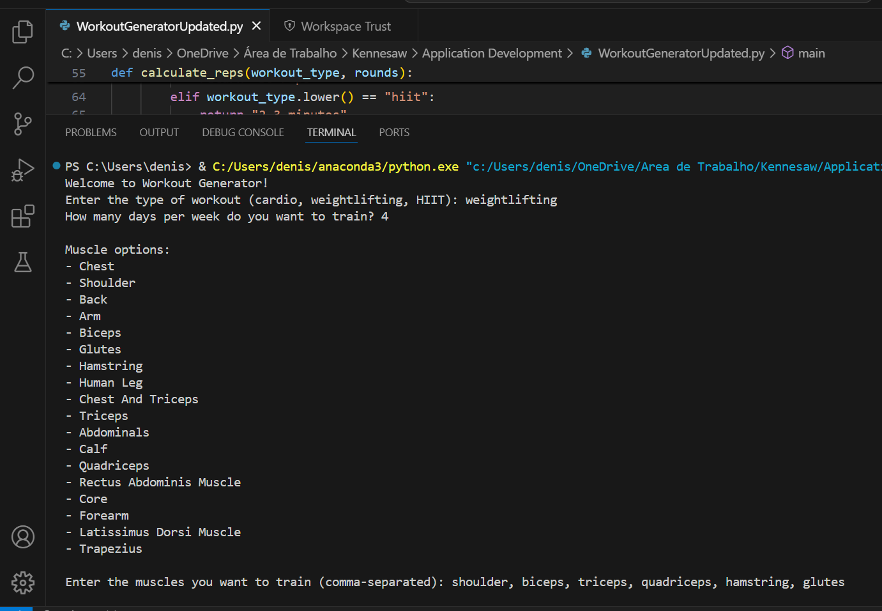
HOW TO USE IT:
STEP BY STEP
Step 1 – Welcome to Workout Generator
Step 2 – Enter the type of workout you want a schedule for (CARDIO, WEIGHTLIFTING, HIIT)
Step 3 – Choose how many days per week you want to train
Step 4 – Choose from a list, the muscles you want to train
Step 1
Step 2
Step 3
List for step 4
Step 4

Slide 7
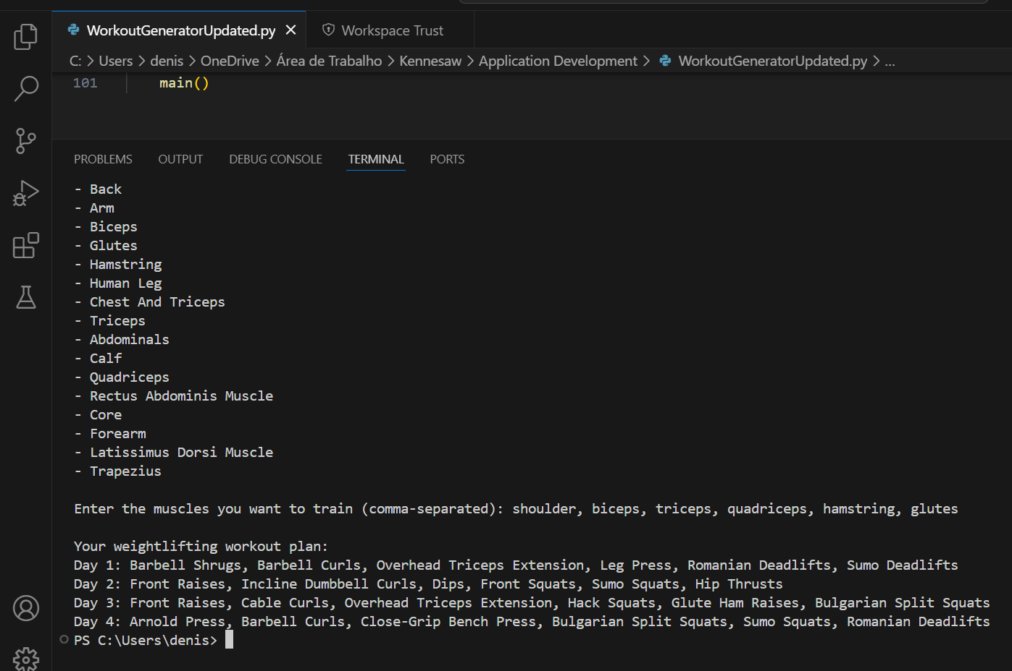
YOUR WORKOUT SCHEDULE IS READY!
AND THAT’S IT!!

Slide 8
TRY IT OUT AND GET YOUR WORKOUT SCHEDULE FOR THE MONTH!!
https://github.com/ksu-is/Workout-Generator

Slide 9

MEET OUR TEAM
DENISE SANTOS DA SILVA ​
Owner

Slide 10

THANK YOU
THANK
YOU
THANK
YOU
THANK
YOU
THANK
DENISE SANTOS DA SILVA​
DSANTOSD@STUDENTS.KENNESAW.EDU

